Slide 1
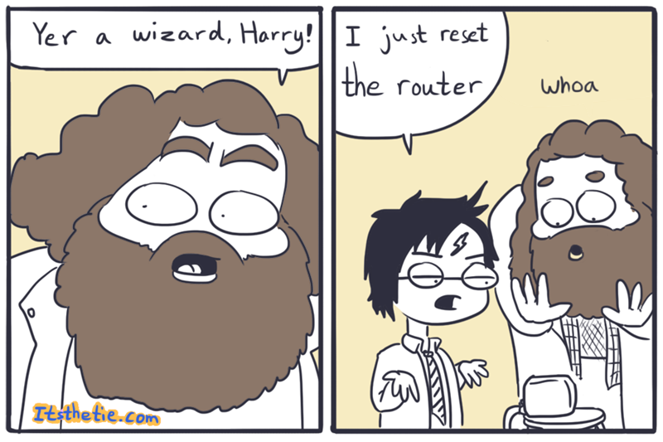
IST346: Networking
Fundamentals

Slide 2

Agenda
Discussion
Content
  Networking
  TCP/IP
  Core Services
  Common Utilities
Wrap-Up

Slide 3
Discussion Questions
What does DHCP stand for? What does it do?
What is DNS? What does it do?
What is the difference between a hub and a switch?
Explain what is meant by a public / private internet address?
Notes:
Give students 1-2 minutes for each question. Its important to provide them with the opportunity to answer the questions based on the reading, labs, and assigned homework.

Slide 4

Lab Debrief
Lab – C
Notes:
Go over the lab questions. With the students. Ask them to take out their answers to the lab questions. And their questions about the lab itself.

Slide 5

What is a Computer Network?

Slide 6
Computer Network Definition
A computer network is two or more devices connected together using a telecommunication system for the purpose of communicating and sharing resources.
A connection between any two communicating devices (computer and printer, or headset and smartphone) could also be considered a network.

Slide 7
Why do we need a network?
To communicate and share resources between multiple computers
To connect to other networks. The Internet is a connection of networks.
Question: What would you do today with computers that are not networked?

Slide 8
Typical Resources to Share
Internet Connectivity
Printers / Speakers / Devices
Storage
Email / Messages
Web Content
Databases
Audio / Video

Slide 9
“The Network is the Computer”
In 1984, John Gage a co-founder of Sun Microsystems coined this phrase.
He had no idea how right he was!
Here are just a few things that are useless without a network…

Slide 10
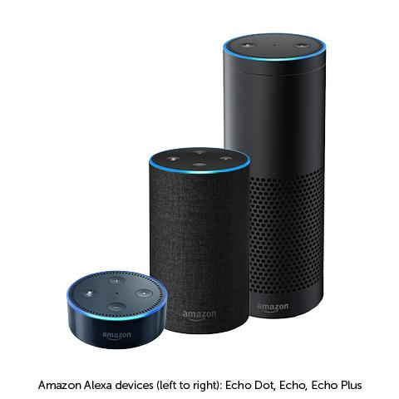

Slide 11
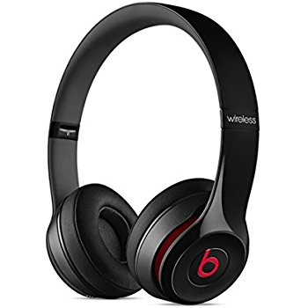

Slide 12
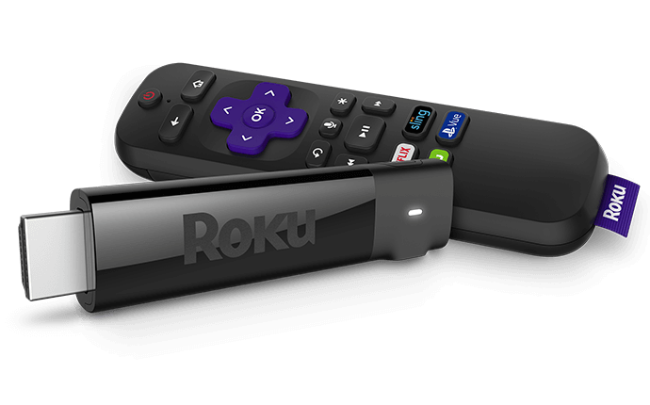

Slide 13
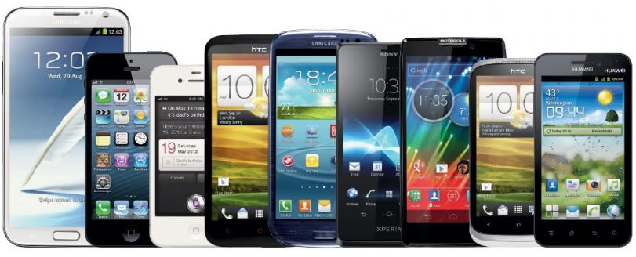

Slide 14

Check Yourself
What are some components of a network for which you are familiar?

Slide 15
Typical Components of a Network
Computers and Peripherals:
Desktops, Laptops, Phones, Gaming Consoles, Servers
Printers, Speakers, Scanners, TV’s, “Smart” devices like bathroom scales and thermostats.
Network Equipment:
Hubs, Switches, Routers, Firewalls, Wireless Access Points

Slide 16
Network Interface Card (NIC)
A circuit board or card that is installed in a computer so that it can be connected to a network.
Provides a computer with a dedicated, full-time connection to a network.
Can employ wired and/or wireless network connectivity.

Slide 17
Wireless Access Point (WAP)
Networking hardware device that allows a Wi-Fi compliant device to connect to a wired network.
Typically connects to a router (via a wired network) as a standalone device, but it can also be an integral component of the router itself.
A WAP is different from a hotspot, which is the physical location where Wi-Fi access to a WLAN is available.

Slide 18
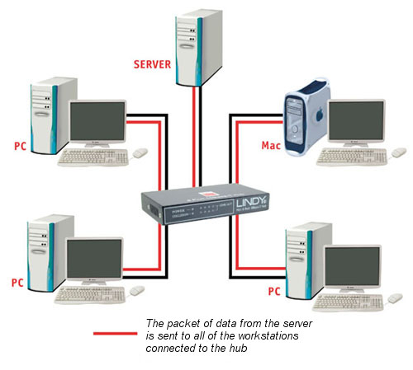
Hubs
Connect multiple Ethernet devices together
Hubs merely repeat signals out to all other ports (broadcast)
Inexpensive, simple way to
connect computers
No smarts, unmanaged
Older Technology

Slide 19
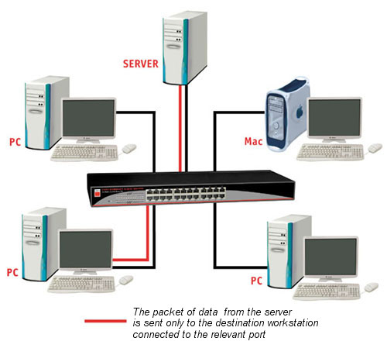
Switches
Connect multiple Ethernet devices together
Switches isolate ports by passing only
data meant for that port.
Filters data packets, and only sends
to the port which is connected to the
destination address.
Offer a variety of management
options.

Slide 20
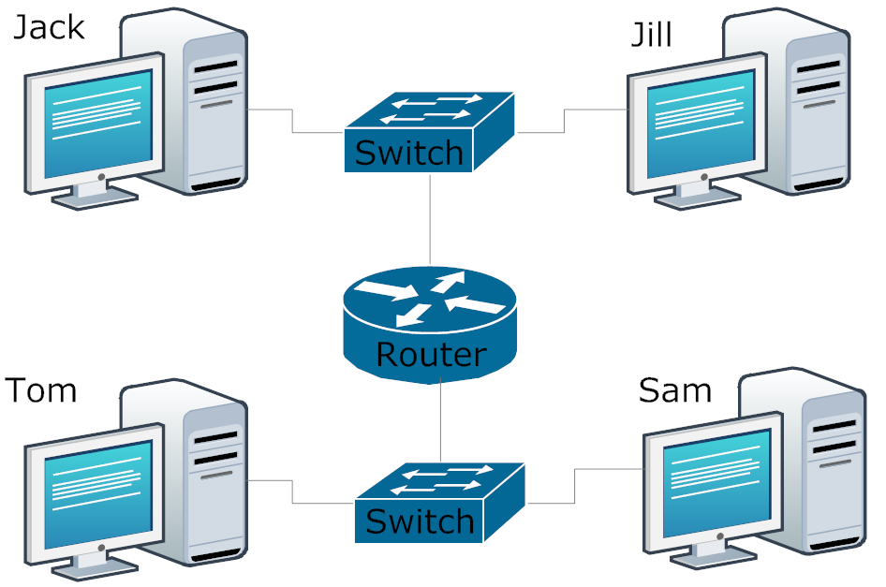
Routers
Act as a junction between two networks, and transfer data between them
Routers do most of the hard work on a network
They make decisions about where all messages travel on a network and whether to pass them
between various networks.
They “bridge” different networks
together.
Can provide additional
networking features: DHCP, NAT,
DMZ, Firewall, VPN

Slide 21
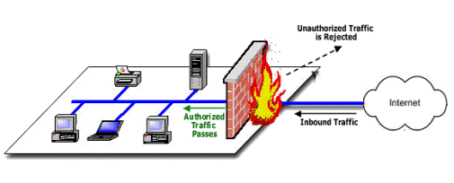
Firewalls
Filter messages or keep users and devices out of private networks.
Keeps unwanted traffic from reaching specific computing devices
Keeps devices from talking to anything but their desired networks and/or devices.

Slide 22
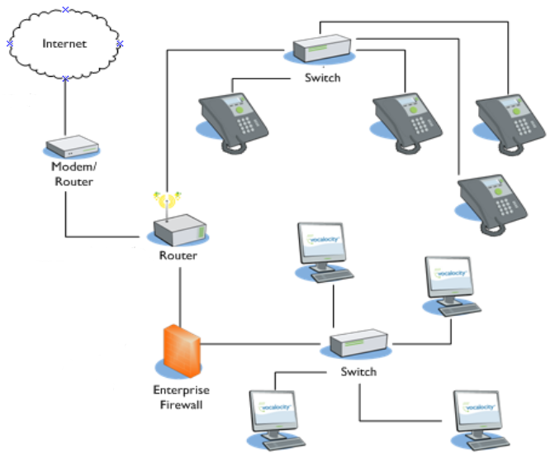
Putting It All Together

Slide 23
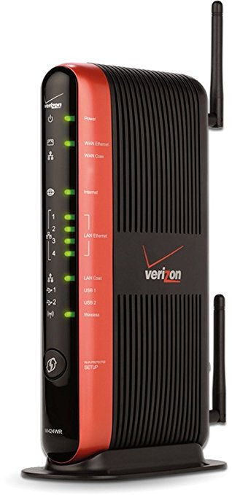
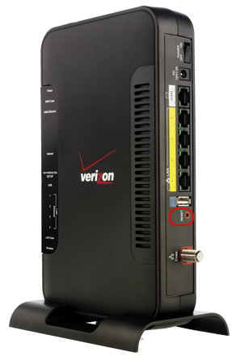
Check Yourself
What is this?
Hub
Switch
Router
Firewall
Wireless Access Point
Notes:
You’re probably seen one of these before in your home. It’s the device your Internet service provider leases to you so that you can access the internet. What type of network device is this?

Slide 24
Core Network services

Slide 25
What is a Protocol?
Standard used to define a method of exchanging data over a computer network
This defines a set of rules that end points on networks use when they communicate.
There are basically 3 types of protocols:
  Application Layer like HTTP or SMTP.
  Network Functionality like TCP/IP or ICMP
  Media Access Layer like 4G LTE, Ethernet, WiFi
Notes:
Application Layer protocols defines how an application exchanges data. Such as in the case of HTTP where it defines how a web browser communicates with a website. Or SMTP which defines how a mail message is sent.
Network functionality layer protocols define how information is transported from one device to another and how the network governs access to a device, similar to how street addresses help us figure out how to get to a destination.
The media access layer protocols define how the device is physically connected to the network, whether by cable, short range, or long range radio signals.

Slide 26
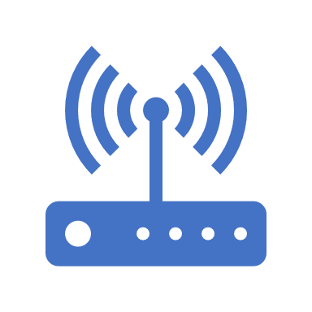
TCP/IP
Transmission Control Protocol/Internet Protocol
Basic communication language or protocol of the Internet or private networks.
Consists of IP address + Logical Port
  IP Address == Destination Device
  Port == “Channel” under which communication occurs.

Slide 27
IP Addresses
IPv4
IPv6
Utilizes 32bits for internet addresses
Allows 4.29 billion possible unique addresses
Format of xxx.xxx.xxx.xxx, where xxx is 0 to 255
  192.168.0 is a class C subnet (containing 255 addresses)
  192.168.0.10 is an address of a specific device on that subnet
  A subnetwork or subnet is a logical subdivision of an IP network.
Designed to address the increasing need for internet addresses.
Utilizes 128-bit addresses, providing more addresses to use.
340 undecillion possible unique addresses.
First 48 bits are the network.
Example of an IPv6 address:
  2601:0681:4200:c5c0:516:f0bb:ac3b:46bd

Slide 28
Common Network Services
DHCP – dynamic host configuration protocol
  Service that automatically assigns IP addresses to connecting devices
DNS – domain name services
  Allows translation of names to IP addresses.
  Clients use DNS caches to store recently obtained Name/IP Address pairs.
NAT – network address translation
  Allows a router to present a single IP address to the Internet.
  Keeps private networks private, while still able to communicate with external resources.
  Used with port forwarding for inbound connections.

Slide 29






NAT with Port Forwarding Example
Request
HTTP Request:
Translate: 1.2.3.4 to
192.168.0.15
port 80 to port 8888
HTTP Request:
To: 1.2.3.4 on port 80
From: 9.8.7.6
HTTP Request
To: foo.com
From: 9.8.7.6
Public Internet
Home Web Server
IP: 192.168.0.15
Port: 8888
Router / Firewall / DHCP
Pub IP : 1.2.3.4
Prv IP : 192.168.0.1
DNS Server
foo.com is
1.2.3.4
IP: 192.168.0.16
IP: 192.168.0.99
IP: 9.8.7.6

Slide 30
NAT with Port Forwarding Example
Response
HTTP Response:
To: 9.8.7.6
From: 1.2.3.4
HTTP Response:
To: 9.8.7.6
From: 192.168.0.15
Public Internet
NAT
HTTP Response:
To: 9.8.7.6
From: 1.2.3.4
Home Web Server
IP: 192.168.0.15
Port: 8888
Router / Firewall / DHCP
Pub IP : 1.2.3.4
Prv IP : 192.168.0.1
IP: 192.168.0.16
IP: 192.168.0.99
IP: 9.8.7.6

Slide 31
Check Yourself
Which service translates names such as www.syr.edu to IP addresses?
Which service translates IP addresses, Typically between public and private?
Which service translates Ports, from public facing ports to a port on a private network?
Notes:
DNS
NAT
Port Forwarding

Slide 32

Your To-Do List
What to work on for next class

Slide 33
Exit Ticket
What one thing did you learn today that you didn’t know before class began?

Slide 34

Questions?

