Slide 1
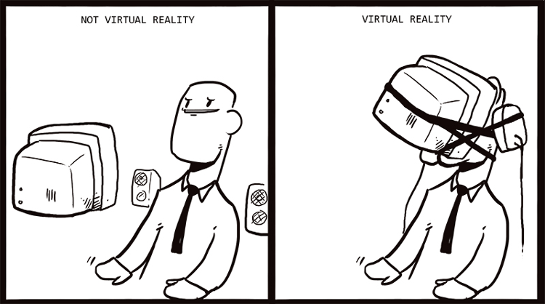
IST346: What Is IT?

Slide 2

Agenda
Discussion
Content
  What is IT?
Wrap-Up

Slide 3
Participation Pop-Quiz
Did you do your homework? Let’s find out in 5 minutes.
Take out a sheet of 8.5x11 paper.
Write your name and email.
Do the authors consider our book technical?
How many exams are issued in this class?
Is there a final exam in this course?
Why does systems administration matter?
Notes:
Give students 1-2 minutes for each question. Its important to provide them with the opportunity to answer the questions based on the reading, labs, and assigned homework.
Go over the answers then collect the papers. Or collect the papers and go over the answers. Whatever works for you.
Varies
No. It is not and explicitly says so.
4 only the highest 3 count for a grade.
No. There is a final presentation
Because computers and networks matter. They are essential to most everything we do in society today.

Slide 4

What is Information Technology?

Slide 5
When you hear “IT” what comes to mind?
Notes:
Write your student’s answers into the space provided and discusss them

Slide 6
Information Technology
Computerized systems consisting of hardware, software and/or networks intended for the storage, retrieval, processing, and transmission of data and information, usually within an organizational or business context.

Slide 7
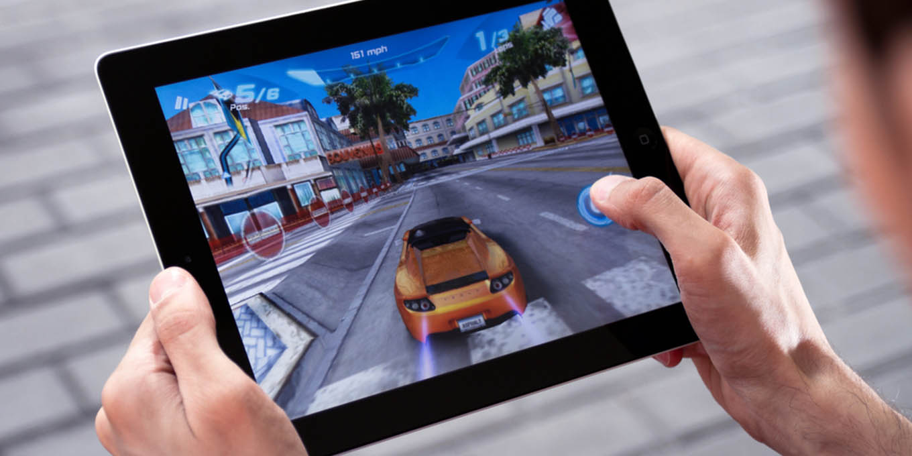
Notes:
A person playing a game on a tablet computer. If this information technology?

Slide 8
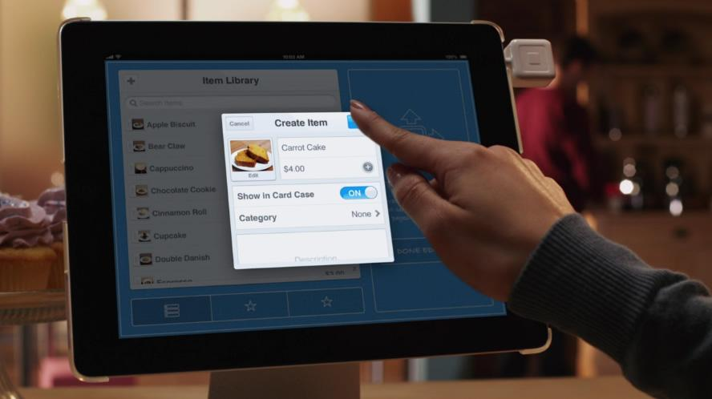
Notes:
A screen shot of a person using a tablet computer in an information technology context.

Slide 9
What about the following?
“Consumer IT”
“Enterprise IT”

Slide 10
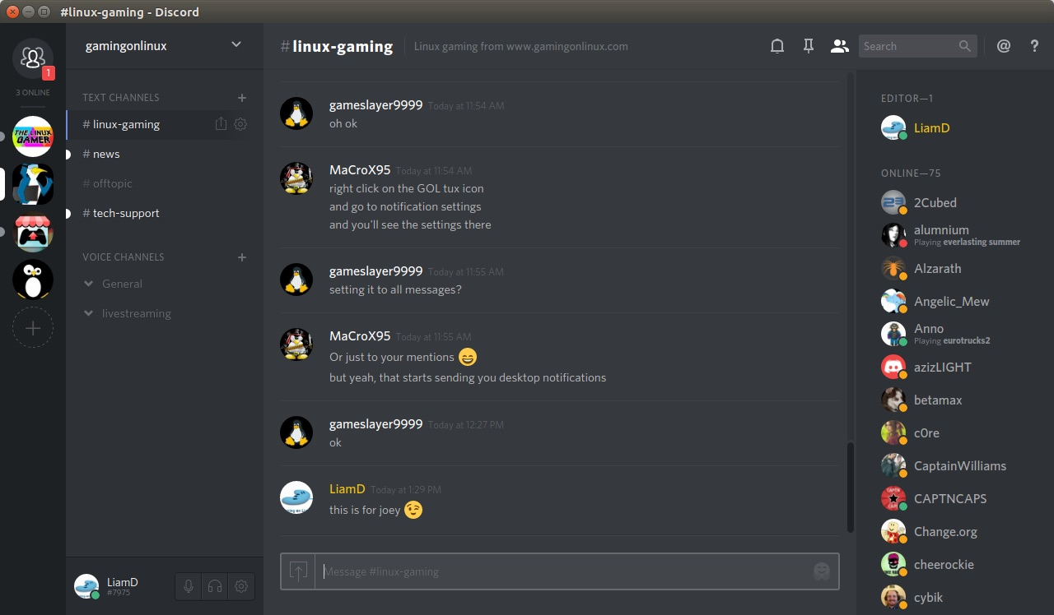

Slide 11
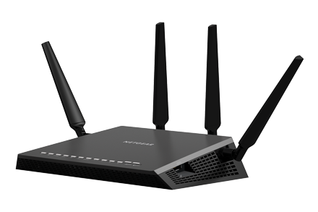
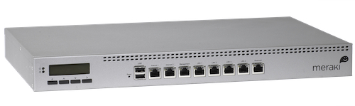

Slide 12
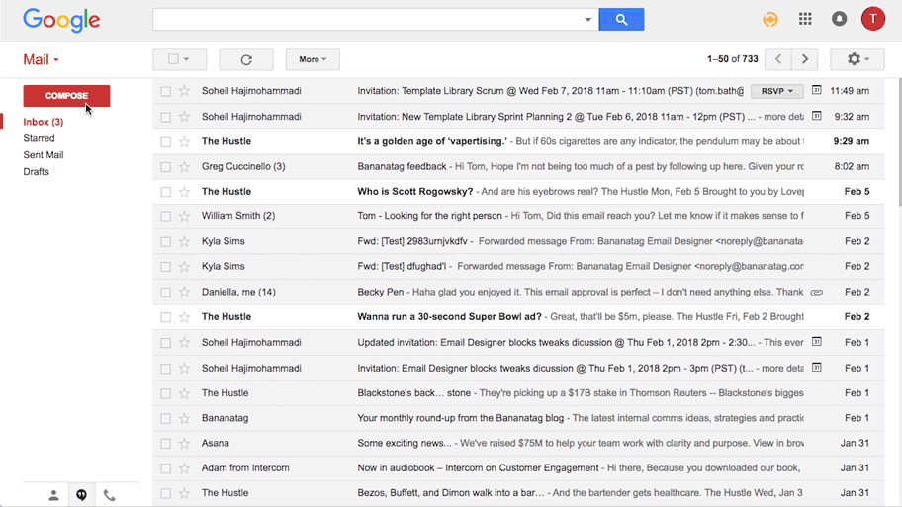
Notes:
Screen shot of google email service gmail. Is this consumer IT or enterprise IT?
The lines are blurred. Gmail started out as consumer IT and now has grown to enterprise IT as well. Many organizations trust gmail to run the email for them!

Slide 13
Check Yourself!
Take a minute to think of an information technology. It can be something you use every day or something you’ve heard of before.
What is it? What does it do?
Is it hardware, software, or both?
Is it consumer IT, enterprise IT or both?
You will be asked to share your answers with the class.

Slide 14
How is consumer IT Managed?
Have you reset your home router?
Does your Thanksgiving consist of “fixing” your parents’ computer?
When there’s an issue with your phone or TV, do you Google how to fix it?
Consumer IT is not managed in an organized fashion because
Consumer IT is not mission critical.

Slide 15
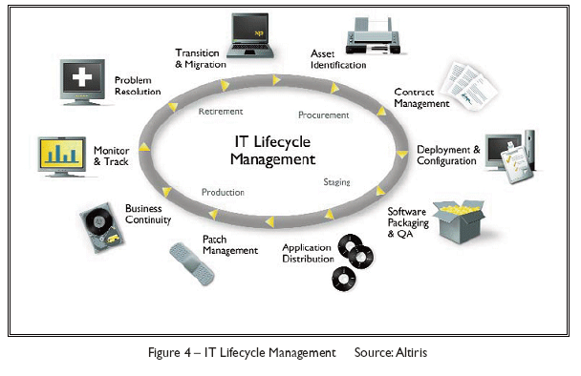
Enterprise IT Management Is Organized
Runs the business.
Needs to be reliable and stable.
Many methodologies exist.
Notes:
Briefly explain the IT lifecycle

Slide 16
Who Manages Enterprise IT?
Entry Level
IT Support Technician
Systems / Network Administrator
Web / Application Developer
Mid-Level
IT Analyst
IT Architect
IT Project Manager
Senior
Directors / Officers in an area Data, Secuirty
Enterprise Architect
CTO, CDO, CIO

Slide 17
The IT Job Title-O-Matic
Pick a Domain…
Then Pick a Role…
Systems
Network
IT
Database
Web
Operations
Business Process
Enterprise Systems
Information Security
Operator
Technician
Developer
Administrator
Engineer
Director
Specialist
Architect

Slide 18
Essential Skills of the IT Professional
Technical Knowledge
1
Customer Focused
2
Creative Thinking / Problem Solving
3
Understanding of the business
4
Time Management
5
Notes:
Technical Knowledge – you don’t have to be the best techie and know every little command, but you do have to understand how it works so that you can manage it.
Customer Focused – this is a customer focused job that is done for people
Problem Solving – Your career will skyrocket if you can devise creative solutions to difficult or costly problems
Understanding the business - You cant manage what you do not understand
Time management – you will get pulled in a lot of directions

Slide 19
Group Activity
IT Skills Inventory

Slide 20
IT Skills Assessment Exercise
GOAL: Inventory the skills within your IT Team.
Get into groups of 3. Each of you should take out a piece of paper.
On a scale from 0 to 10, where 0 is not at all and 10 is expert individually rate your IT skills. E.g. Technical Knowledge = 3. be honest!
Compare your skills with your group mates, and select the highest skill among your group.
Report your scores to the class.
Technical Knowledge
1
Customer Focused
2
Creative Thinking / Problem Solving
3
Understanding of the business
4
Time Management
5
Notes:
When my new IT Director was hired at the company for which I was a Support Technician, this was one of the first exercises she made us do to inventory the skills of our IT team. This helped us to identify our strengths and weaknesses as an individual and as a group. We found out quickly we were not very customer focused and it served as a point of emphasis among our team!

Slide 21

Your To-Do List
What to work on for next class
Notes:
ALWAYS CONSULT THE SYLLABUS

Slide 22

Exit Ticket
Share one thing you learned today that you didn’t know before class!

Slide 23

Questions?

